Slide 1
MM215 Experiment-5
FILTERING THROUGH PROGRAMMING
IN MODERN-DAY DATA ACQUISITION

Slide 2
Measurements and sensors
Need to measure physical quantities
Displacement/Velocity/accelaration
Temperature
Force/pressure/Load
Flow-rate/Level of liquids and solids
Voltage/Current/Power
Concentration of a solution/pH/pK
Sensors are used to make such measurements

Slide 3
Sensors and signals
Sensors and transducers
Sensors convert one engineering variable in to another. For example-
Current → voltage
Temperature → voltage
Force → Resistance
Engineering variable to be measured
Sensor
Sensor output
Sensor output is frequently referred to as ‘signal’
→ Voltage

Slide 4
Sensor signals & noise
Sensors are not ideal. All sensor outputs have noise.
Thus, all engineering measurements are coloured by sensor noise
The sensor noise needs to be removed before a measurement can be meaningfully used
Sensor
Input = x(t)
y(t) ..where y(t) = f(x(t))
+ n(t) ..[random noise]

Slide 5
Sensor noise
Sensor output usually consists of DC or AC voltage, often referred as signal.
Noise implies, existence of signal components which do not arise due to the input
As sensor input and output are functions of time, noise component is also a function of time
Noise is usually measured as noise voltage, or noise power in sensor output

Slide 6
Sensor noise
If the sensor output is expressed in frequency domain, sensor noise can be seen as unwanted frequency components.
How to remove this noise
Signal
Filtration
Low pass
High pass
Band pass
Band reject
Rel. Intensity
Noise has high frequency components
Noise has low frequency components
Noise is evenly spread out
Frequency

Slide 7
Filtration
Traditionally electrical and/or electronic circuits perform filtering of noise
Modern practice is to use computers for measurements and controls of engineering systems
But computers work only on discretized data often obtained through ADCs
As computers are presented with noisy data, there is a need to filter it by employing data processing techniques.

Slide 8
Data acquisition by computers
Sampling of signals by using data acquisition systems
Sensor → Analog signal conditioning →
Sample & Hold → ADC → digital data →
Digital Data→ Digital signal conditioning →
Sanitised digital data → recording/display/DAC
Sampling rate requirements
Sampling theorem

Slide 9
Sampling of data
Sampling rate

Slide 10
Sampled data
Sampling rate

Slide 11
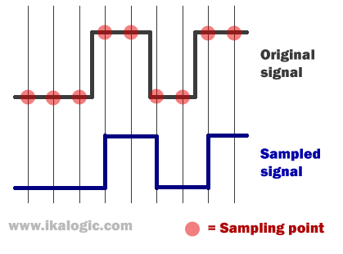
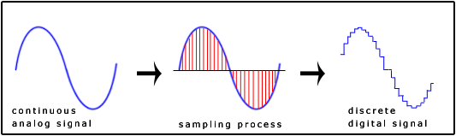
Impact of sampling rate

Slide 12
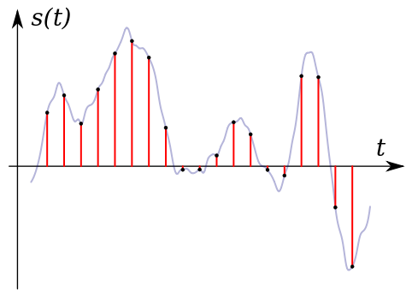
Impact of sampling rate

Slide 13
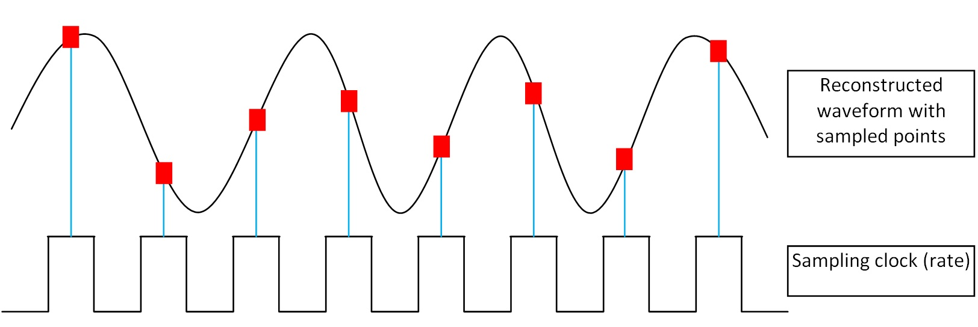
Reconstructed waveform
Loss of information due to low sampling rate

Slide 14
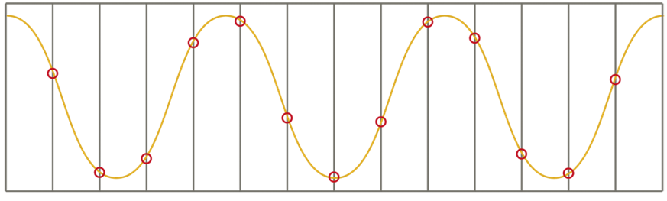
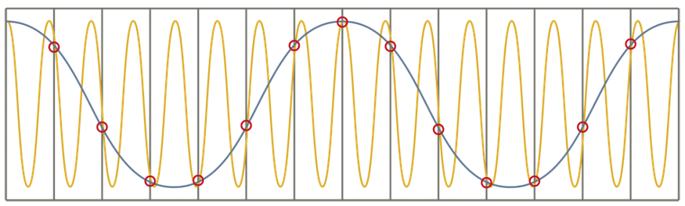
Aliasing due to low sampling rate
Low freq.
High freq.

Slide 15
Low pass filtering
y(k+1)= a u(k) + (1-a) y(k), 0 < a < 1
0 1 2 3 4 5 6 7 8 9 11 13 15 17
k

Slide 16
ADC/DAC connectivity with uC
ADC
L
A
T
CH
DAC
START
WR
DAC OUT
This line shared between ADC and DAC
END OF
CONVERSION
INTR
RD
CS
READADC
μC
PORT-0
DACLATCHENABLE
CHIPENABLE
PORT-2
Making WR=0 starts a conversion and INTR becomes=1. At the end of conversion INTR becomes 0. Tying INTR with WR ensures continuous conversions.
To read converted value, make RD=0, CS=0, and read from P0.
For sending an output to DAC→
Output value on P0 (make sure CS=0)
Make DACLATCHENABLE =1 and then back to 0

Slide 17
ADC connectivity with CPU Pins
ADC
L
A
T
CH
(P1.2)
START
WR
END OF
CONVERSION
INTR
RD
CS
(P1.3)
READADC
DACLATCHENABLE
CHIPENABLE
(P1.5)
(P1.4)

Slide 18
Steps to read ADC & display on P2
#include <REG52.H>
sbit DACLATCHENABLE=P1^5;
sbit START= P1^2;
sbit READADC=P1^3;
sbit CHIPENABLE=P1^4;
Initialization : Define port bits P1.2-5
START=READADC=1
Measure:
Wait for START to become =0
When START=0
READADC=CHIPENABLE=0
Configure P0 in input mode
Read converted ADC value from P0
READADC=CHIPENABLE=1
Write data on P2
Repeat from 1
READADC=1;
START=1 ;
Void main(void) {
unsigned char adcdata;
While (1) {
while (START ==1){;}
READADC=0; CHIPENABLE=0;
P0=0xff;
adcdata=P0;
READADC=1;
CHIPENABLE=1;
P2=~adcdata;//P2 is inverted
} }

Slide 19
Measure and filter data. Output to DAC
#include <REG52.H>
//Define ADC control pins
sbit DACLATCHENABLE=P1^5;
sbit START= P1^2;
sbit READADC=P1^3;
sbit CHIPENABLE=P1^4;
void main(void)
{ //Main loop begins here
unsigned char adcdata,
previousdata=0;
//Setup ADC control lines
DACLATCHENABLE=0;
READADC=1;
CHIPENABLE=1;
while (1) { //infinite loop begins
while (START ==1){;} //Wait for start pin to go low
READADC=0; //Setup ADC read
CHIPENABLE=0; //Pins
P0=0xff; //Set P0 in input mode
adcdata = P0; //Read data from ADC
READADC=1; //Restore ADC read
CHIPENABLE=1; //Pins
//Following line filters data
P0= ~(char) ( (float)adcdata*0.05 + (float)previousdata*0.95);
Previousdata = adcdata ;
DACLATCHENABLE=1; //send to
DACLATCHENABLE=0; //DAC
} //infinite loop ends
} //and ends here

Slide 20
Suggested programs
Read from ADC and output read value on P2
Read from ADC and output directly to DAC and simultaneously display on P2
Read from ADC Filter data and output to DAC and simultaneously display on P2
Add the following delay function to time ADC measurements (see next slide).
Structure the program by converting read-adc routine into a function which is called from main()

Slide 21
Suggested programs
//delay function
//call as msec(1) for 1msec delay
void msec(unsigned int x)
{unsigned char j;
while (x--> 0)
{for (j=0; j <125; j++) { ; } }}
Code example in box uses the delay routine to generate 100msec delay between subsequent measurements and send measured data to port P2
#include <REG52.H>
void msec(unsigned int); //Define prototype
sbit DACLATCHENABLE=P1^5;
sbit START= P1^2;
sbit READADC=P1^3;
sbit CHIPENABLE=P1^4;
void main(void) {
unsigned char adcdata;
While (1) {
READADC=1;
START=1 ;
while (START ==1){;}
READADC=0;
CHIPENABLE=0;
P0=0xff;
adcdata=P0;
READADC=1;
CHIPENABLE=1;
P2=~adcdata;
msec(100); //Introduce 100ms delay
} }
→ Place delay routine here ←

Slide 22
Over to experiment-5 lab lecture

